Slide 1
IE6600_Project
Xiaoyang Ye
XueMeng Gao

Slide 2
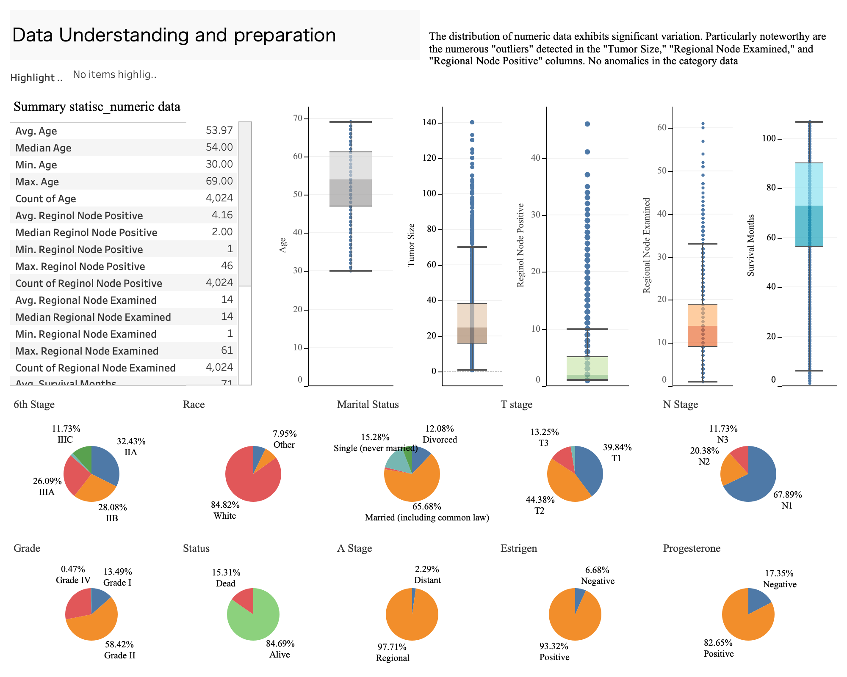

Slide 3
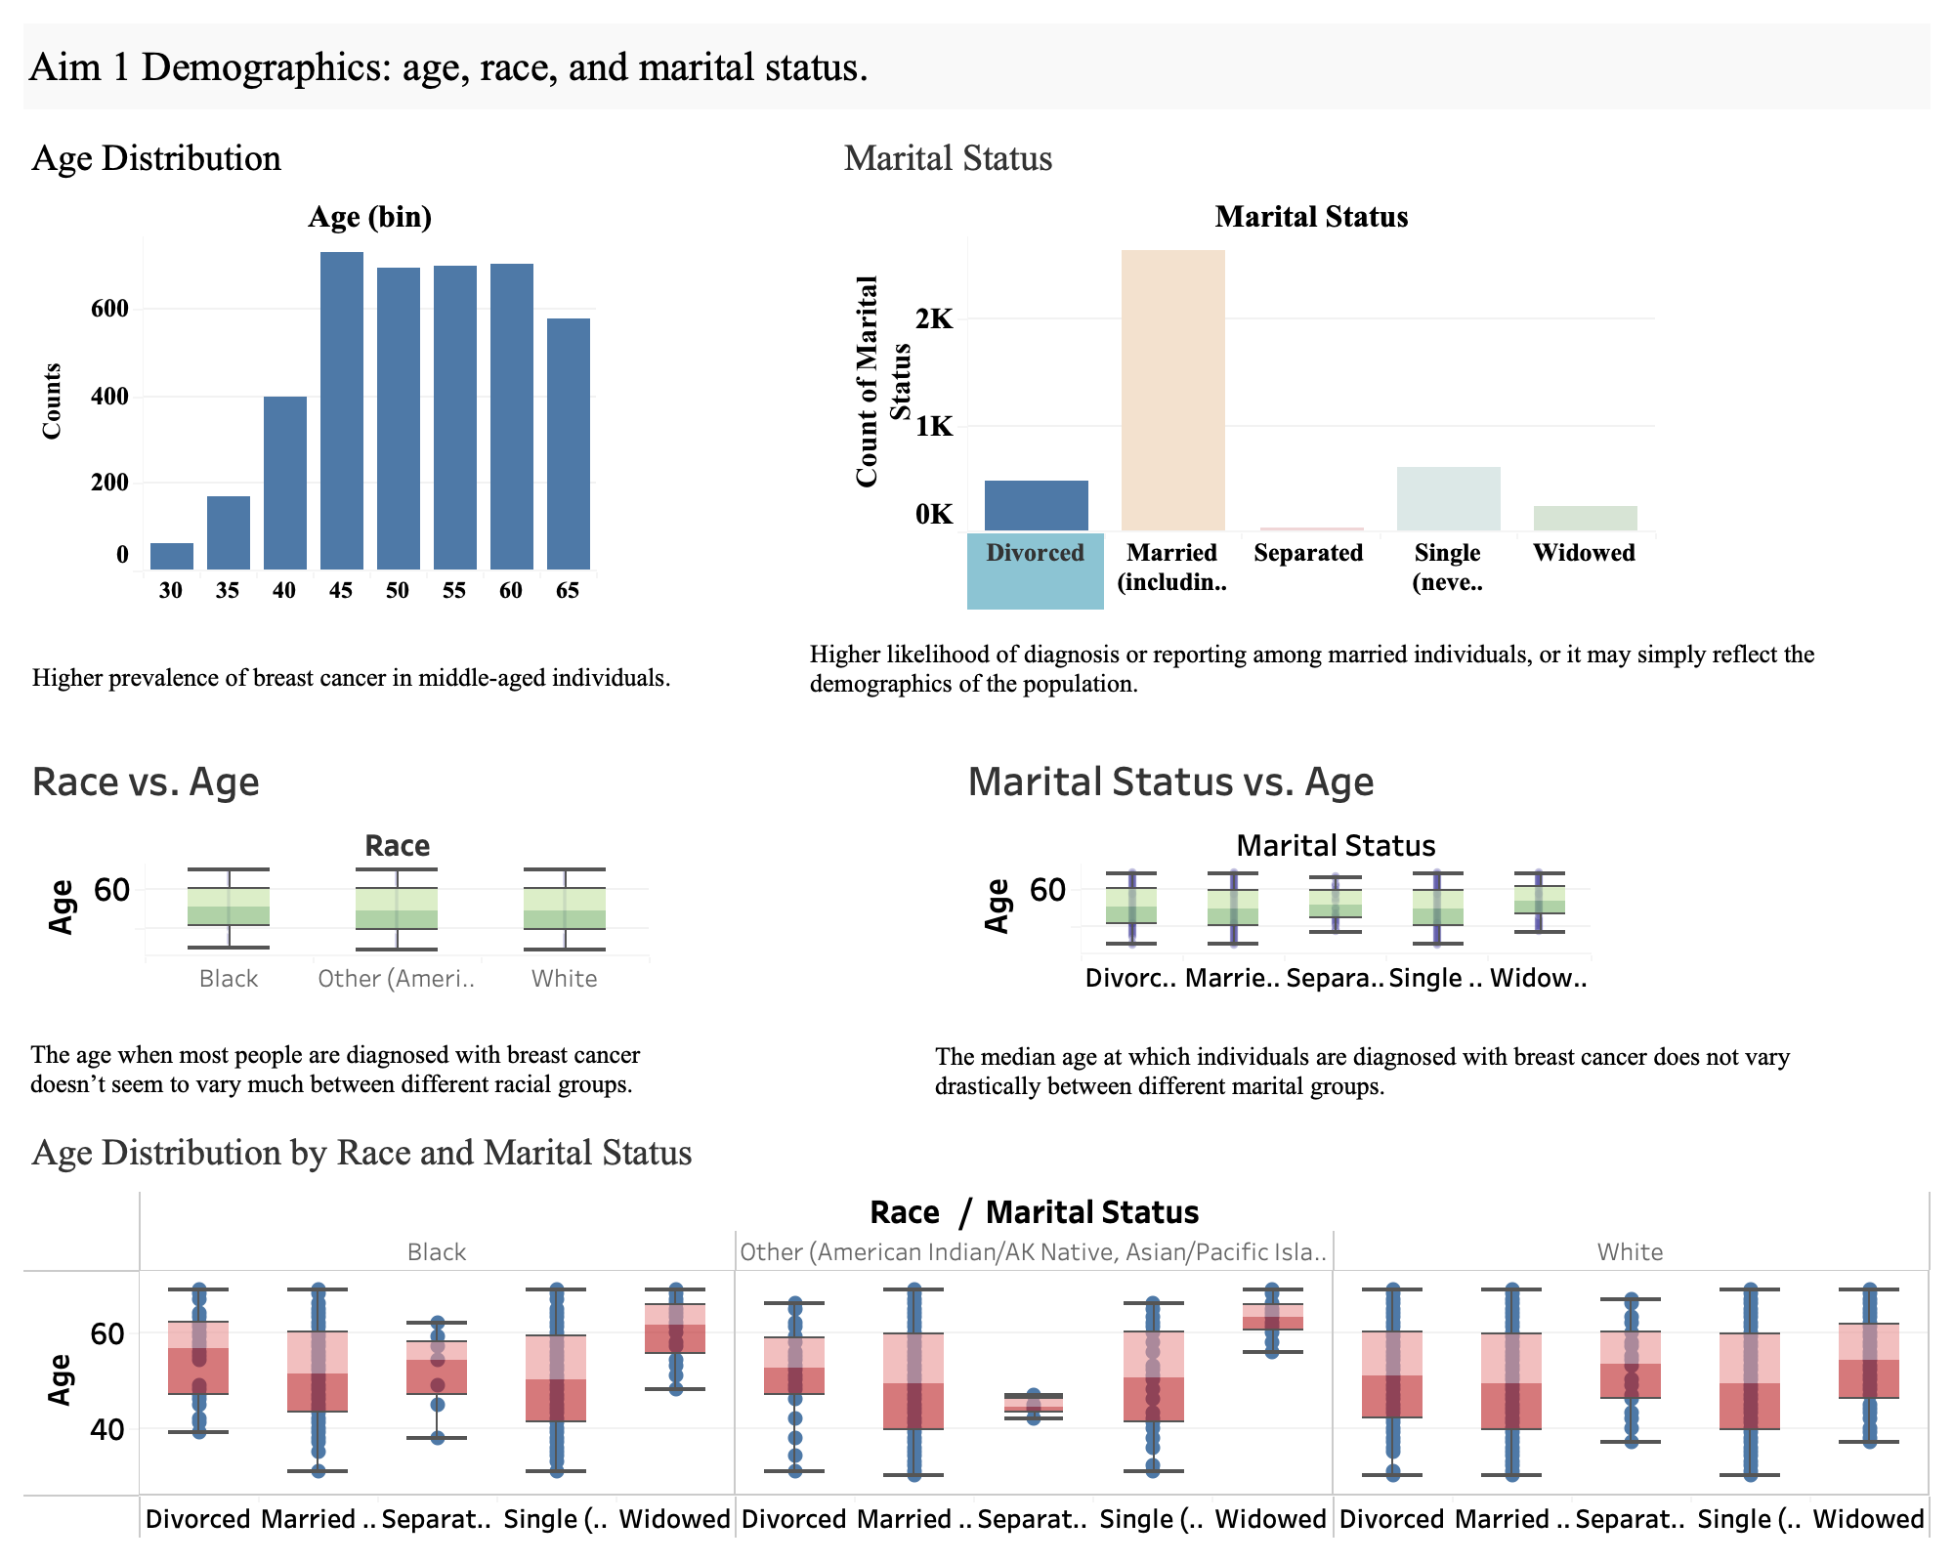

Slide 4
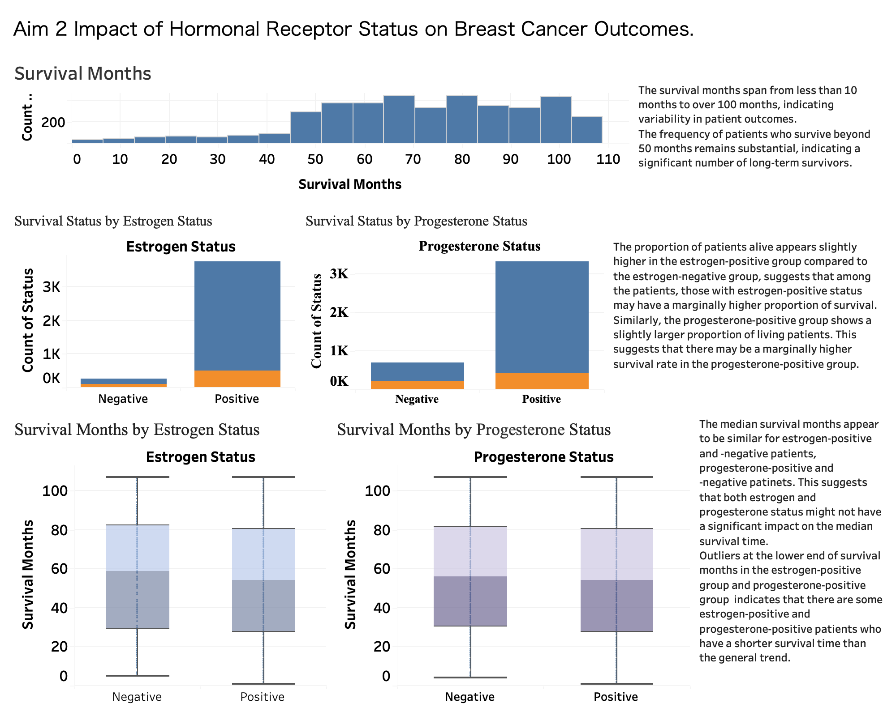

Slide 5
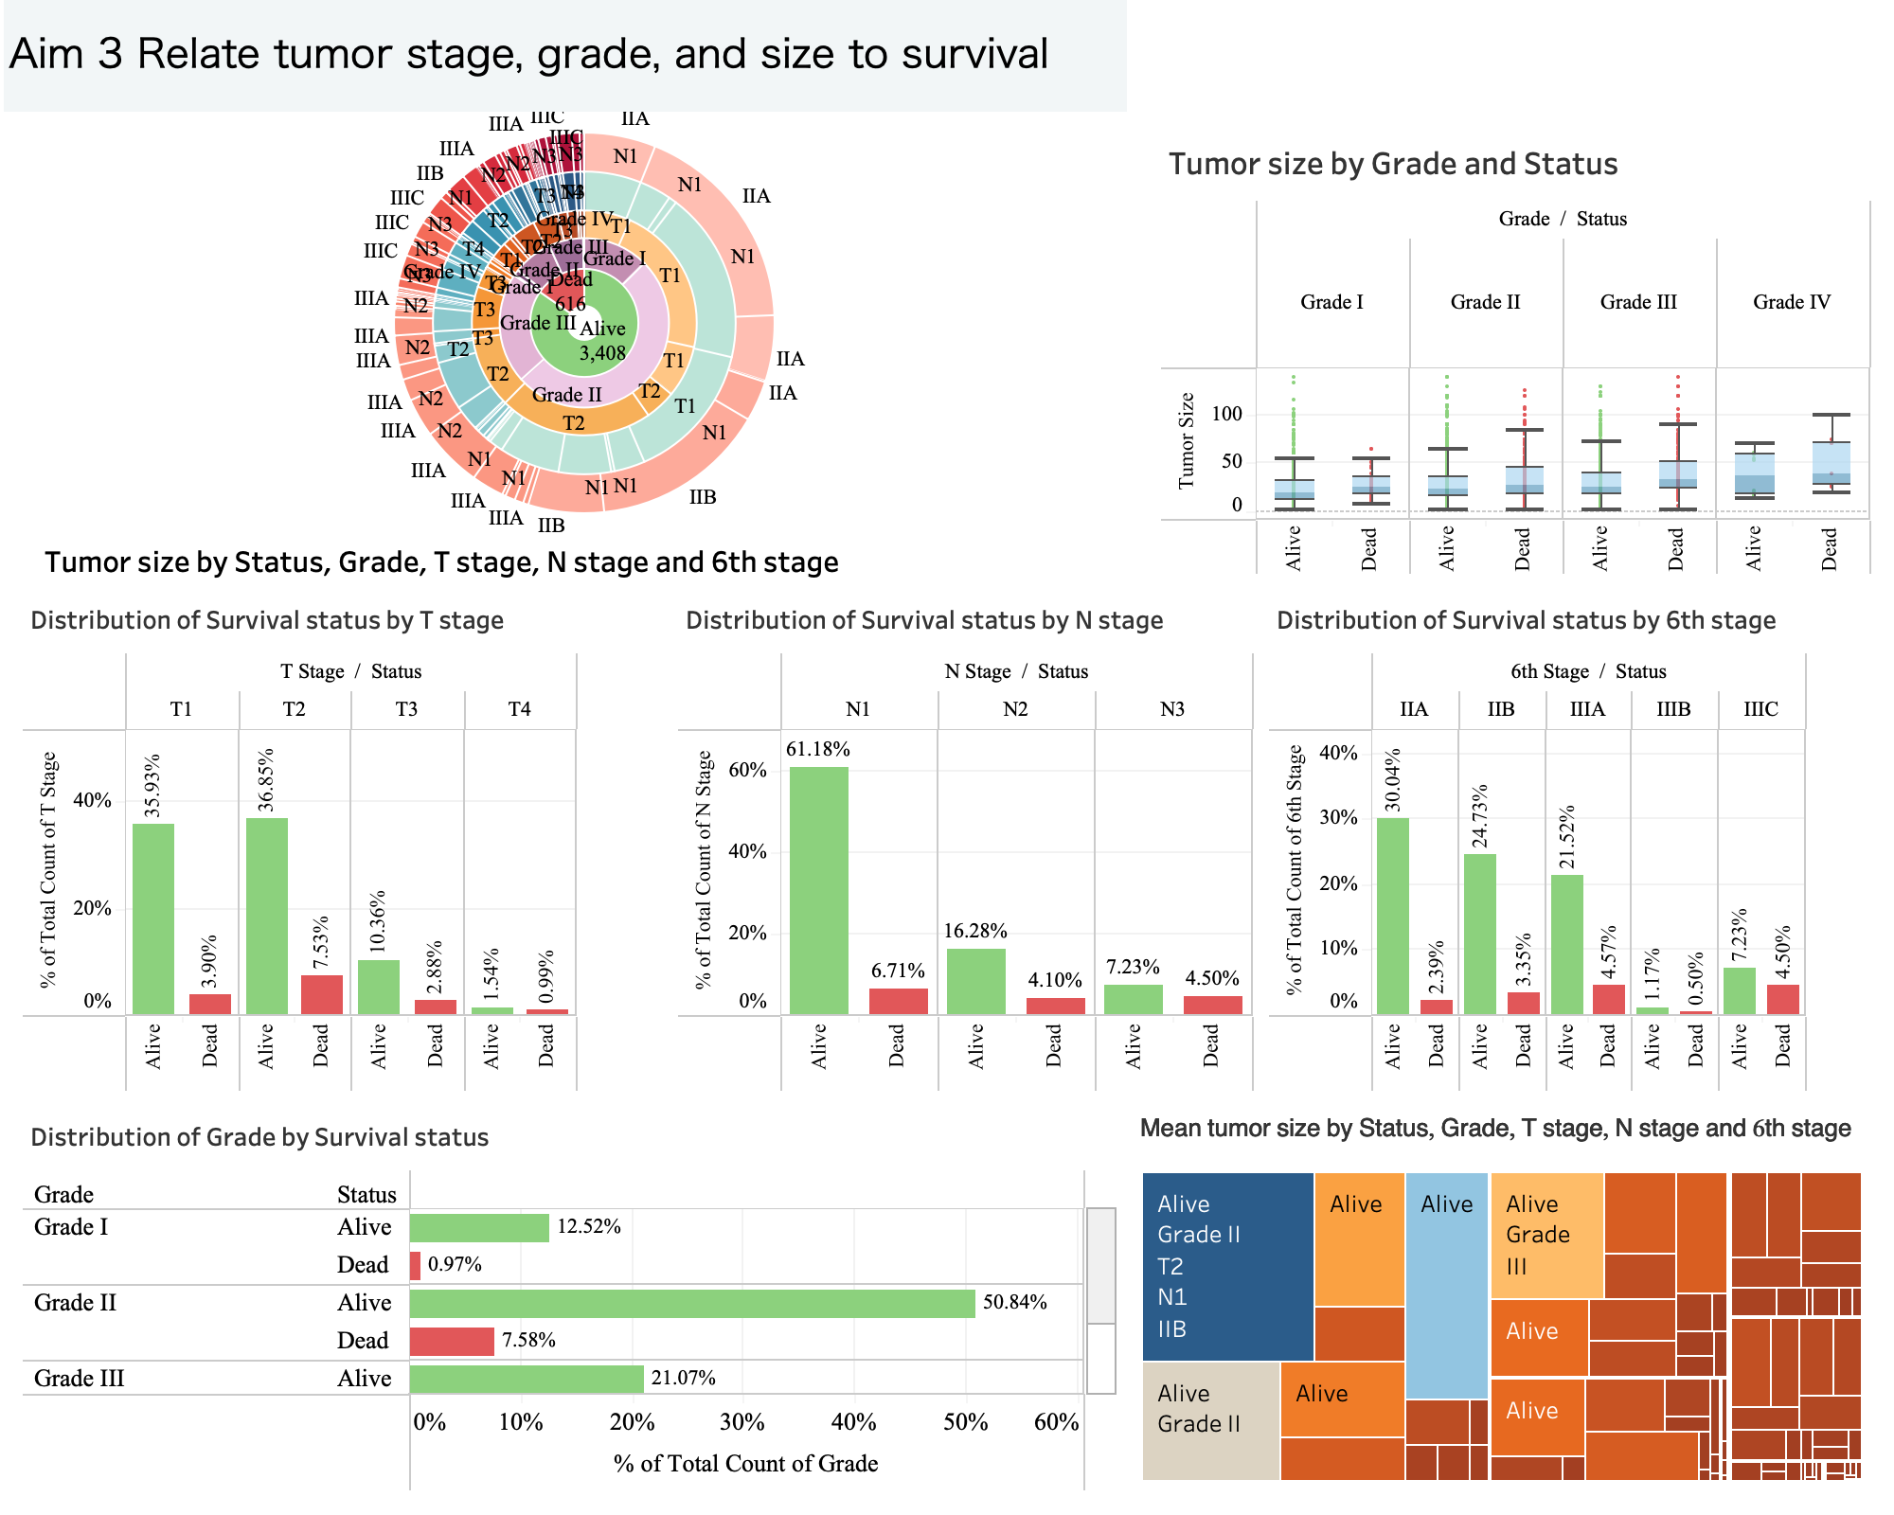

Slide 6
